Slide 1


INSURANCE CLAIM
PREDICTION
BFSI-DOMAIN

Slide 2

CONTENT
01
ABOUT CAR INSURANCE
02
STEPS TAKEN
03
CHARTS AND GRAPHS
04
INSIGHTS
05
CONCULSION

Slide 3




ABOUT CAR INSURANCE
Car insurance is designed to protect you against financial losses if you're involved in an accident or the vehicle is damaged in some way.
Instead of paying out-of-pocket for auto accidents, people pay annual premium to an auto insurance company; the company then pays all or most of the costs associated with an auto accident or other vehicle damage.

Slide 4





STEPS TAKEN
Data cleaning
EDA
Prediction
DATA PREPROCESSING
EDA
PREDICTION
Used charts and graphs for visualization to understand the important variable feature
Imported the data. Checked for missing and duplicated values. Cleaned the incorrect data
Used various machine learning algorithm to predict the out come

Slide 5
DATA VARIABLES
FREQUENCY
SEVERITY
POLICY_TENURE
AGE OF POLICY HOLDER
AGE OF CAR
AREA CULSTER
POPULATION DENSITY
MAKE,SEGMENT,MODEL
FUEL TYPE
MAX TORQUE AND MAX POWER
REAR BRAKE TYPE
TRANSMISSION TYPE

Slide 6

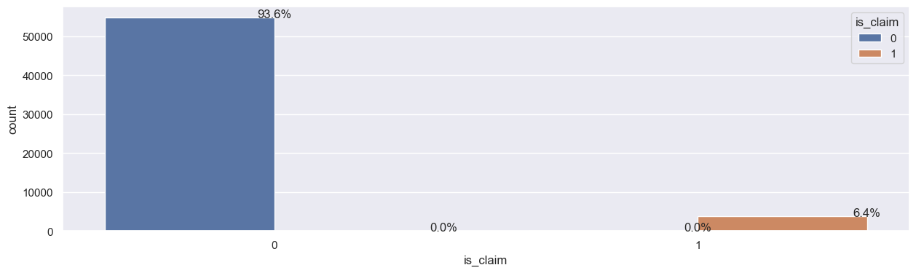

CHARTS AND GRAPHS
Insight: Most of the insurances
are not claimed with only 6.4% are claimed

Slide 7
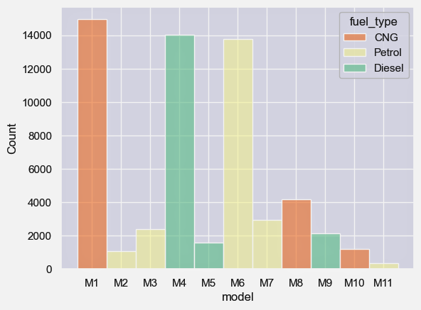
Insight: The fuel type of the car has 3 variant: CNG,Petrol and Diesel with theri respect to the car model.Highest insured car is with CNG fuel type

Slide 8
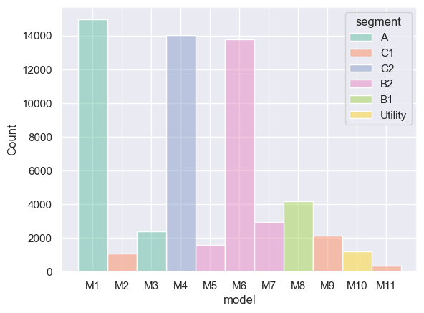

Insight:
The model of the car with the segment(compact,sedan,SUV..etc). The M1 model ihaving percentage compared to the rest of the models.

Slide 9
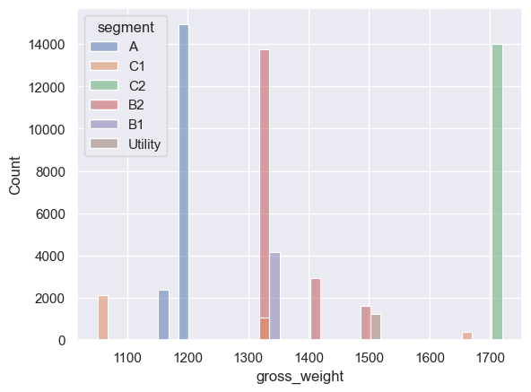

INSIGHT
The gross weight of the sedan,compact and suv.The highest gross weight is the A model with 1200

Slide 10
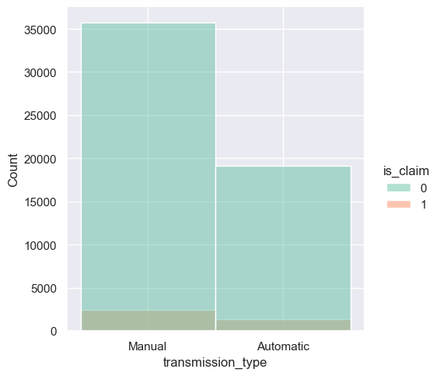
Insight: Mostly the manual cars are getting claimed than the automatic cars

Slide 11
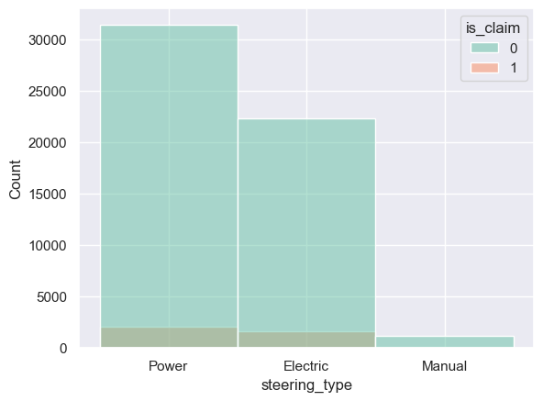
Insight:
Most of the cars owned by the policy holders are power type steering. In that Power is getting compared compared with electric cars than manual cars

Slide 12

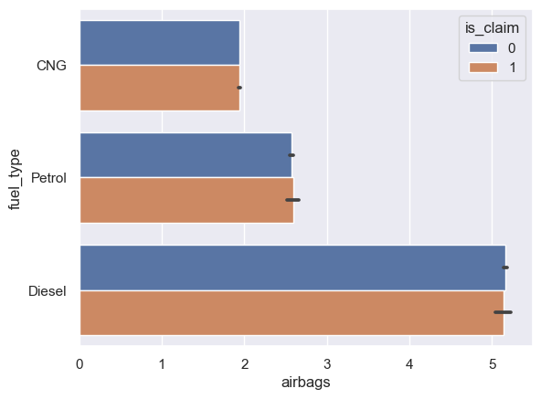

Insight:
The are 5 airbags in diesel vehicle which is getting claimed than the CNG and Petrol fuel types.

Slide 13
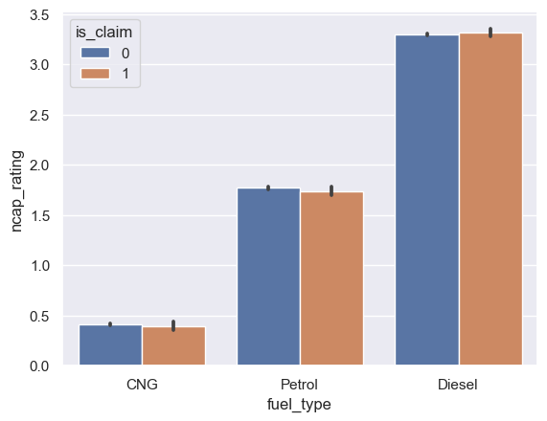

Insight:
The safety rating of the car according to the New Car Assessment Program (NCAP) is more in Diesel type vehcile and the claim frequency is more.

Slide 14
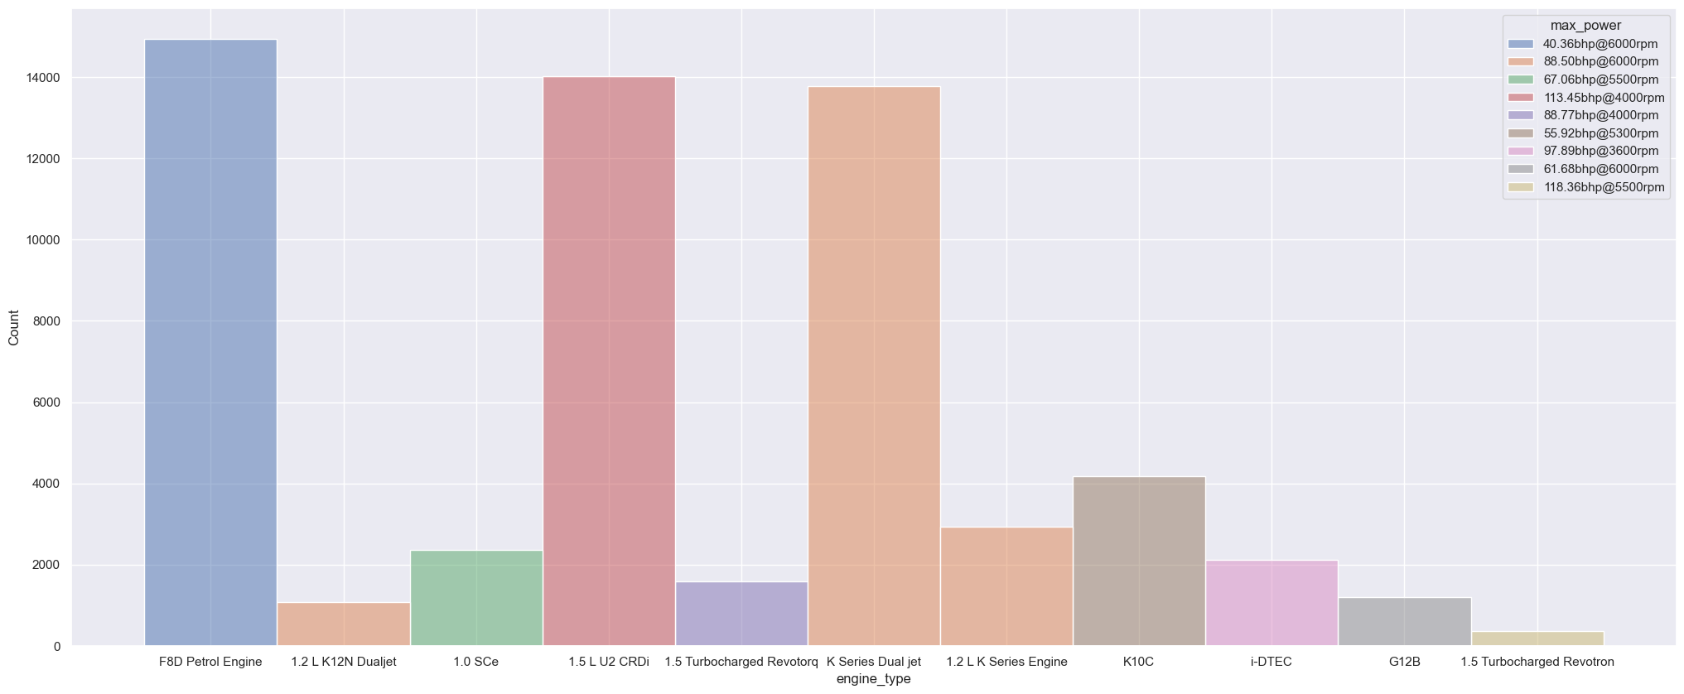

Insight:
The engine type of the policy holders car with their maximum power capacity.F8D petrol engine have the maximum power compared to other engines

Slide 15
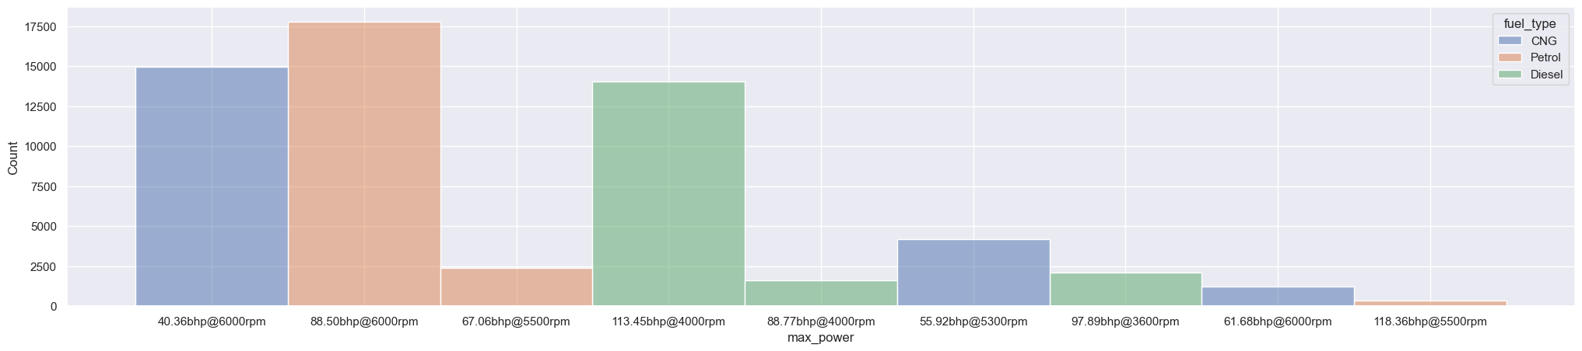

Insight:
The maximum power is obtained by petrol cars compared to other cars.

Slide 16
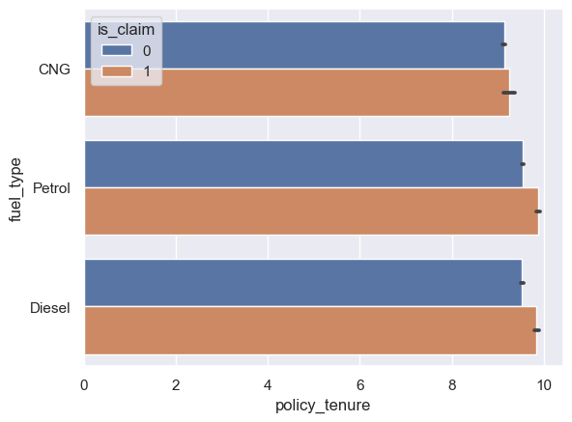

Insight:
The policy tenure is almost equal between the diesel and petrol with the claim rate .

Slide 17
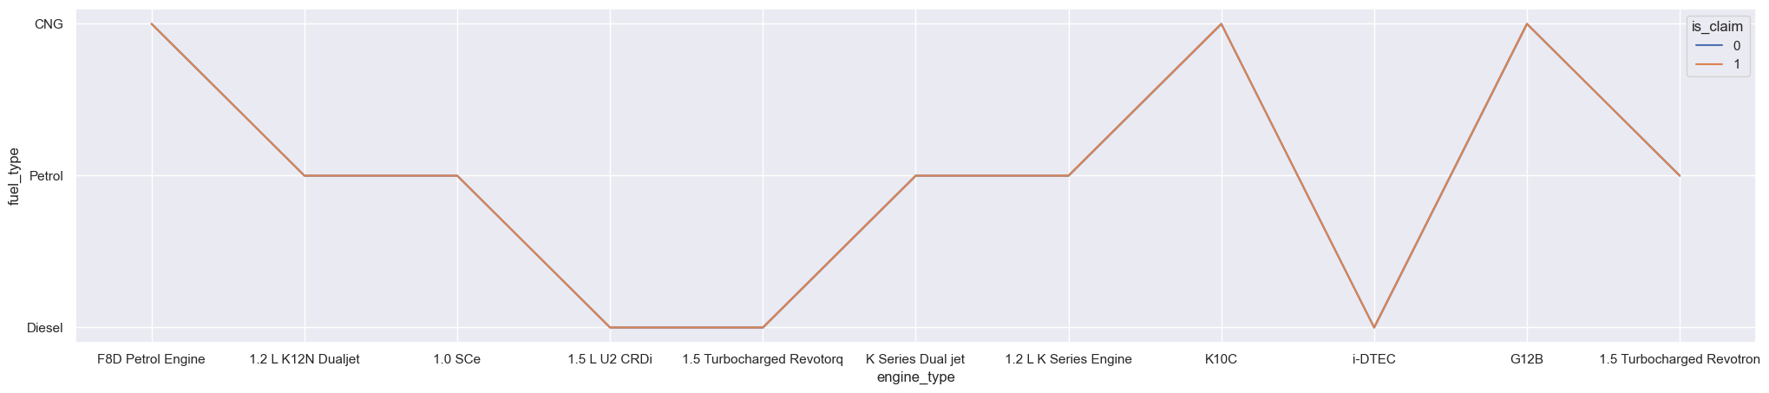
Insight:
All the engine type got the claim. So its safe to easy engine type is not the issue in claim severity.

Slide 18

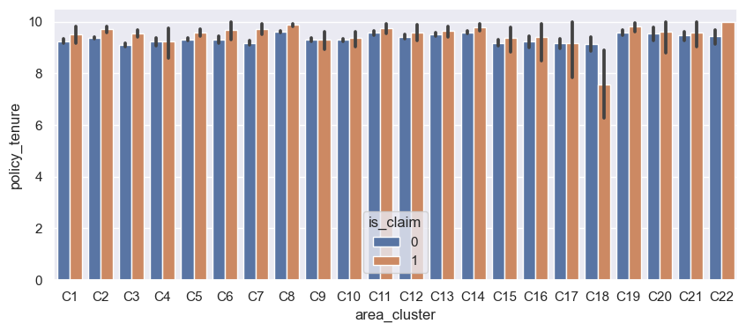
01
Insight:
The policy tenure was taken by the area of the people are almost equal. Except C18 claim rate is low compared to others

Slide 19
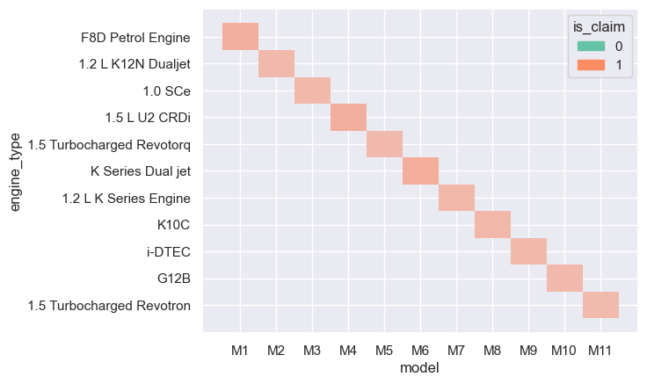

Insight:
The engine type of the each model variant .All the engine and model variant of the respective engine is not the risk factor for the claim approval

Slide 20
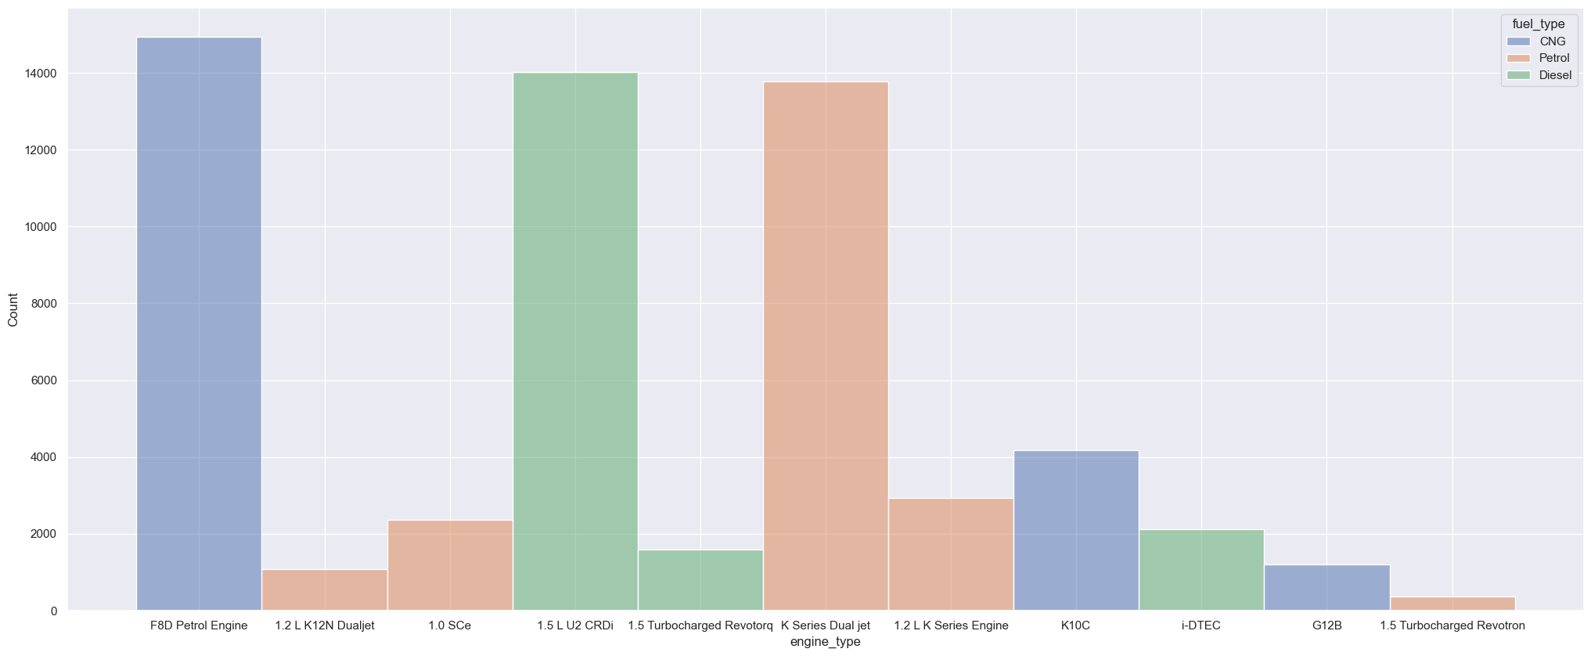

Insight:
The petrol engine car are the maximum count compared to other fuel vehicle type

Slide 21
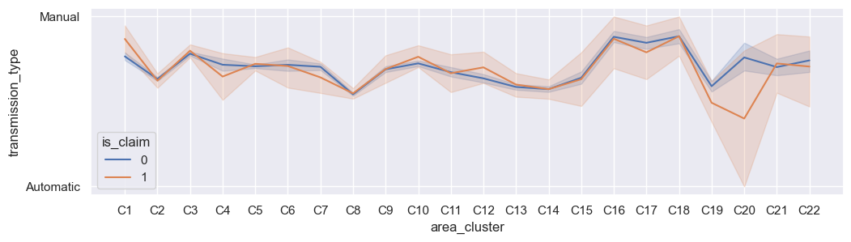

Insight:
Most of the population/area people using manual compared to automatic cars with the decrease in claim rate in C20 area.

Slide 22
FEEDBACK AND RECOMMENDATIONS
The important feature is age of the car its leading to high frequency and severities.
Vehicle type : The make,model,age and segment impact claim severity.High performance cars tend to have higher repair cost making claims more expensive.
Higher mileage or maximum power vehicles are likely to lead high claim severities. May consider the primary use and estimate annual mileages to determine premiums.
Geographic factor plays a role in care insurance risk assessment.Its leading to increased claim frequencies and potentially higher premiums
Safety features or good saftey rating may associated with low claim frequencies and severity.

Slide 23

THANK YOU

